Slide 1


Presented by: Mangesh Arun Suryawanshi
Authored by: ALM Team

Slide 2
Document History
Version No. | Authored/Modified by | Remarks/Change History | Date <dd- mon-yy >
1.0 | Mangesh Suryawanshi | Updated the PPT as per latest standard PPT template for trainings. | 19-10-2020

Slide 3
Course Structure
Target audience
Level | 1 - 4
Prerequisites | Basic knowledge of command line
Training methods | PPT, Hands-on, etc.
Evaluation | Quiz.

Slide 4
Agenda
Version Control Systems
Git Introduction
Git Architecture
Git Operations & Commands
Parallel Development
Git Workflows

Slide 5

Version Control Systems (VCS)
Manages changes to files over time
File changes termed as ‘Versions’
A tool to manage versions of a project
Version Control

Slide 6
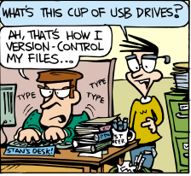
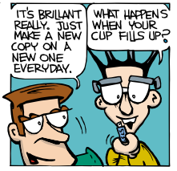
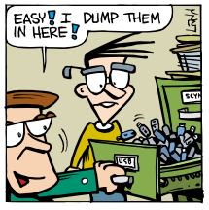
Version Control Systems
Version Control

Slide 7
Version Control Systems
VCS are software tools that help you to:
Collaborate with your team
Store versions as snapshots
Trace your changes
Rollback easily
Maintain the backup of your code
Version Control
Systems

Slide 8
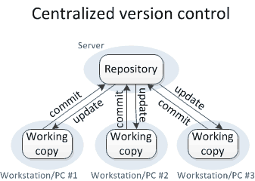
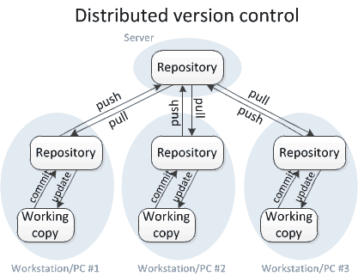
Version Control Systems: Flavors
Centralized Version Control System
2. Distributed Version Control System
Version Control
Systems

Slide 9
Distributed Version Control Systems (DVCS): Advantages
Every clone is a backup
Works offline
Pretty fast (SPEED)
Handles changes well
DVCS
Advantages

Slide 10
Distributed Version Control Systems (DVCS): Advantages
Easy branching and merging
Reduce the management activities
Everything is local (almost)
Reduced dependency on network connectivity
DVCS
Advantages

Slide 11
End of section - 1

Slide 12

Who am I?
Who am I ?

Slide 13
Why GIT?
Free and open source
Simple design
Excellent branching and merging
Fully distributed
Handles large projects efficiently
GIT
High speed
Strong support for non-linear development
Git Introduction

Slide 14
Git Directory is where Git stores the metadata and object database for your project
Staging Area stores information about your commit. Also called ‘Index’.
Working directory is a single checkout of one version of the project
Git Architecture
Git Directory
Staging Area
Working Directory
Checkout the Project
Git Architecture
Stage Files
Commit

Slide 15
Git Directory
.git contains information for version control
4 sub-directories:
4 files:
hooks - scripts to be invoked after corresponding Git command
info - additional info about your repository
objects - Git’s warehouse to store your data (blobs) indexed by SHAs
refs - pointers to commit objects
Git Architecture
config - configurations
description - description of git repository
HEAD - current branch
index - staging area
Notes:
Here "object" includes:
blobs(files)
trees(directories)
commits(reference to a tree, parent commit, etc)

Slide 16

Basic Workflow
Git Repository
Fetch
Push
Local Repository
Init or Clone
a repo
Basic workflow
Commit
Checkout Head
Staging Area
Stage the
changes
Working Folder

Slide 17
End of section - 2

Slide 18

Git Operations & Commands
git init
Creating Repository
add origin
status
Git
Operations & Commands
push
Syncing Repository
Making
Changes
add
pull
commit
Parallel Development
branch
merge
rebase

Slide 19
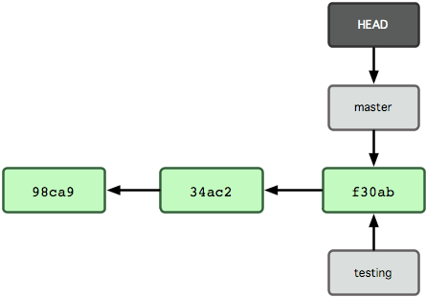
Parallel development: Branching
Branches are pointers to a specific commit
A commit changes its location
Current branch – check the Head
Branching Strategies

Slide 20
Parallel development: Merging
Merge is joining two or more development histories together
Way to combine the work of different branches
Allows to branch off, develop a new feature & combine (merge) it back in
Merging Strategies

Slide 21
End of section - 3

Slide 22
Git Workflows
Git Workflow is a recipe or recommendation for how to use Git to accomplish work in a consistent and productive manner
Guidelines rather than concrete rules
Can have mock-tail of different workflows to suit your needs
Git
Workflows
Major workflows are:
Centralized workflow
Feature branch workflow
Gitflow workflow
Forking workflow

Slide 23
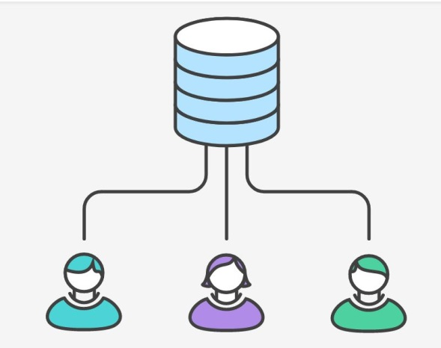
Centralized Workflow
Comfort of subversion, advantages of Git
Gives every developer their own local copy of entire project
Access to Git’s robust branching and merging model
Git
Workflows

Slide 24
Feature Branch Workflow
Each feature has its own dedicated branch instead of master
Easy for multiple developers to work on a particular feature without disturbing the main codebase
Encourages collaboration between developers
It also means the master branch will never contain broken code
Git
Workflows
Master
Feature 1
Feature 2

Slide 25
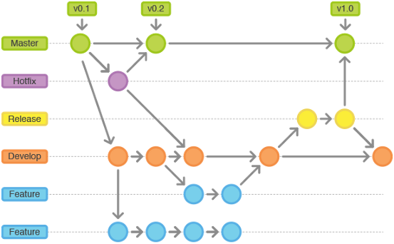
Gitflow Workflow
Branches are created based on software development lifecycle
Can be customized based on project requirement, team size, etc.
Provides a robust framework for managing larger projects
Git
Workflows

Slide 26
Forking Workflow
Fundamentally different from the other workflows
Gives every developer a server-side repository
Each contributor has two Git repositories: 1. private local 2. public server-side
The result is a distributed workflow that provides a flexible way for large, organic teams (including untrusted third-parties) to collaborate securely
Git
Workflows

Slide 27
End of section - 4

Slide 28
Git Best Practices
Small and logical commits
Review code before committing it
Never delete unmerged remote branches
Never put broken code on the master branch (test first!)
Try not to break things (don't do two weeks’ worth of work in one commit)
Always use a clear, concise commit message
When making larger changes, consider branches
Make sure your name and email are right
Git
Best Practices

Slide 29


Copyright © 2020 Cybage Software Pvt. Ltd. All Rights Reserved. Cybage Confidential.
www.cybage.com

Slide 30
Test Your Knowledge Quotient for GIT
Q1: What is Git? Is it an Open Source?
Q2: Who developed git?
Q3: How does git store data?
Q4: Which command will create a local copy (or backup) of your remote repository?
Q5: Which git workflow is generally used for open source projects and why?
Q6: Can we have more than one remote repository to track?
Q7: What is the command to save changes to remote repository?
Q8: Where are the git hooks stored?
Q9: Can we push git hook to remote repository?

Slide 31
Important Links
https://explainshell.com/explain?cmd=git+--version
https://www.atlassian.com/git/tutorials
https://www.edureka.co/blog/git-tutorial/
https://git-scm.com/book/en/v2/

Slide 32


Thank You!
11/27/2020
www.cybage.com
Copyright © 2020 Cybage Software Pvt. Ltd. All Rights Reserved. Cybage Confidential.

